Slide 1
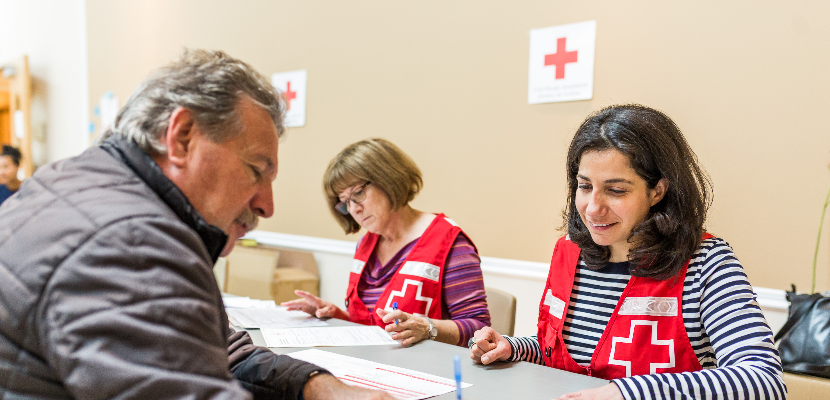
The Red Cross is there
Every day, we are present in your community.

Slide 2
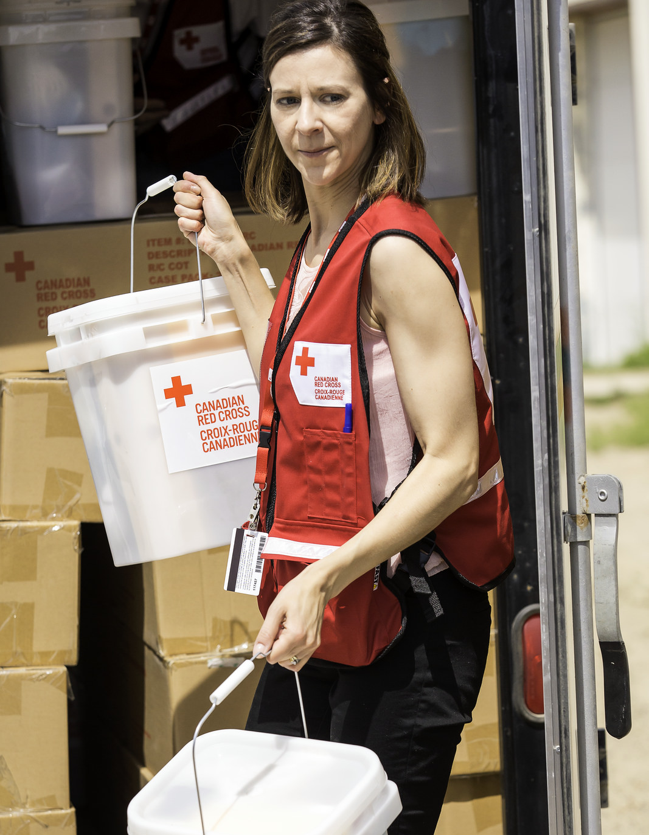
Our humanitarian commitment in Canada
    Every 3 hours, Canadian families call on our help and we assist on average 92 Canadians daily
    13,800 volunteers are active in our communities
    Our teams are ready to help those affected by disasters, 24/7

Slide 3
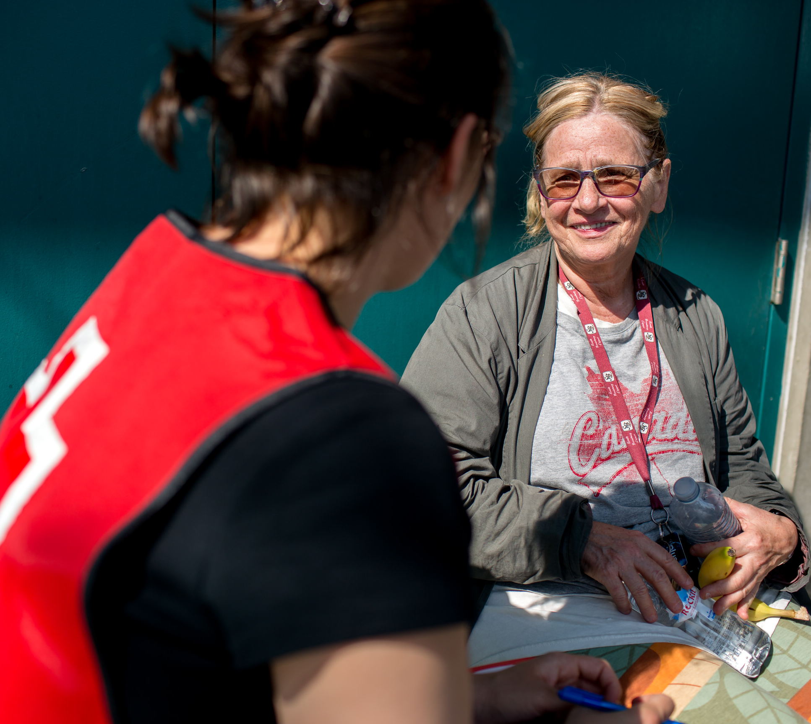
Our volunteers provide the essentials on a daily basis
    Comfort, support and information
    Shelter, food and emergency clothing
    First aid and personal services

Slide 4
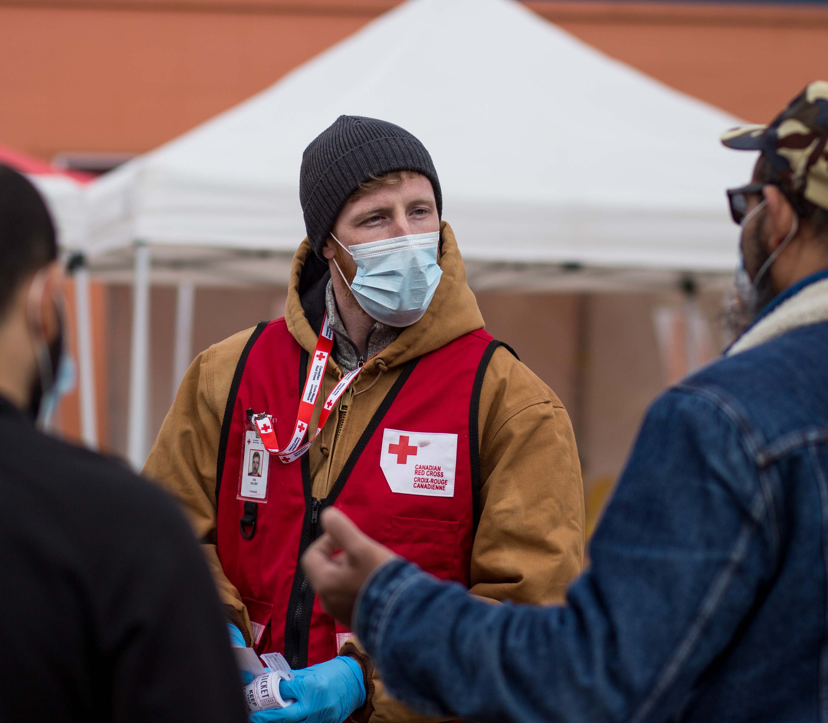
Your impact, in the midst of an emergency
    “People were so grateful to see us setting up that even folks who weren’t impacted stopped by to say thanks.They’d dealt with us after the fire and knew that we’d do the same work again.”
    Ian Dalsin, volunteer for the Canadian Red Cross

Slide 5
COVID-19 – Novel Coronavirus
    During this pandemic, we are all impacted by a disaster
    Our staff and volunteers continue to provide essential Red Cross humanitarian assistance.

Slide 6

Financial snapshot (2019)
90%
Program expenses
7%
Fundraising expenses
TOTAL SPENDING
3%
Governance & General Management expenses

Slide 7
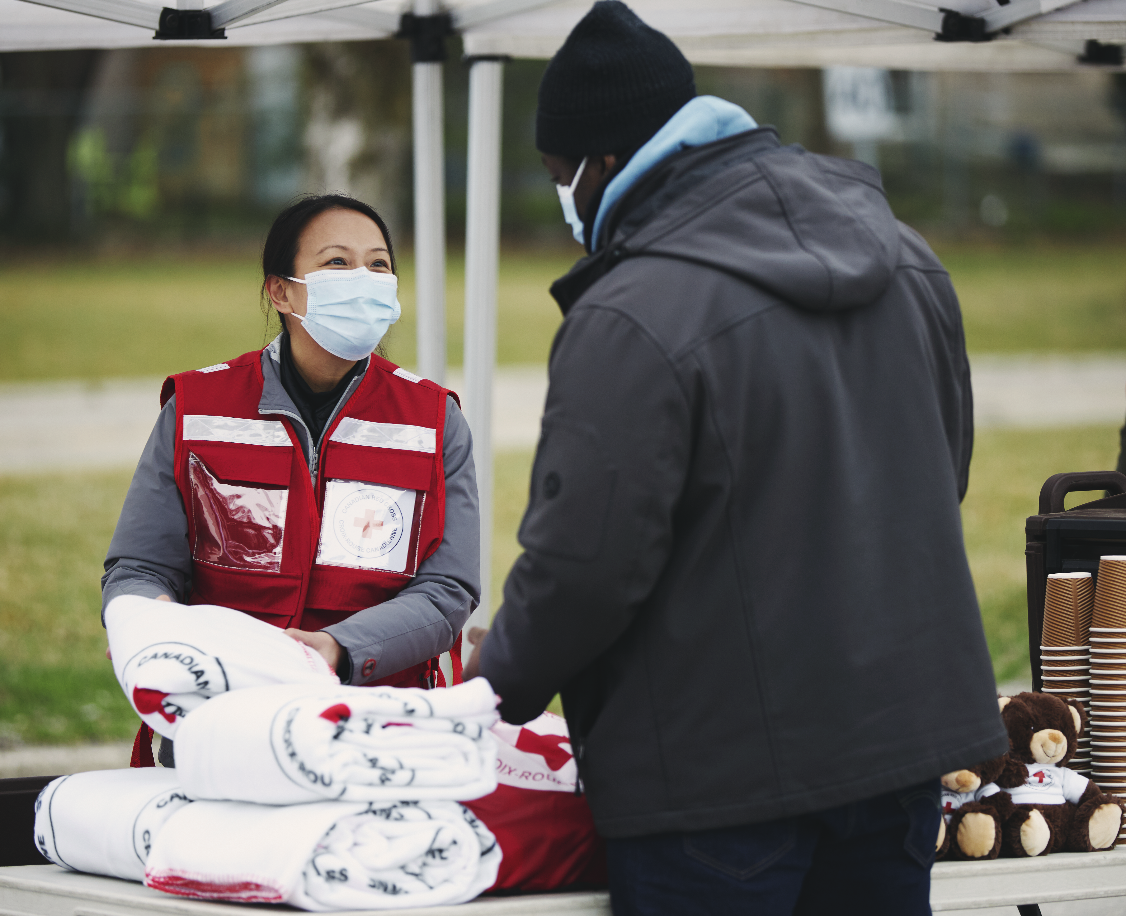
Your generosity at work
    630,000 donors support the Red Cross.
    Every year, you are there.
    Thanks to donors like you, the Red Cross is ready to assist those in need.

